Slide 1


calorie
calculator
presented by team 7

Slide 2


Members
01 - Gurudath
02 - Saad Bin
03 - Yogini S
04 - Rohith C S
05 - Punith S

Slide 3

Introduction
The Calorie Calculator program is a user-friendly tool developed in C that helps individuals estimate their daily caloric needs based on scientifically proven formulas. The program is designed to calculate two essential metrics:
1. Basal Metabolic Rate (BMR):
BMR represents the number of calories your body requires at rest to maintain basic physiological functions like breathing, circulation, and cell production. It is calculated using specific formulas for men and women, considering factors such as weight, height, age, and gender.
2. Daily Calorie Needs:
By factoring in activity levels, the program calculates the total calories an individual needs in a day to maintain their current lifestyle, from sedentary habits to intense physical activity.

Slide 4
Key Features:
Interactive Input Validation: Ensures users provide valid data for gender, weight, height, age, and activity levels.
Customizable Activity Levels: Supports five activity categories, from sedentary to extra active, making the results more personalized.
Scalability for Multiple Users: Allows calculations for multiple users in a single session.
This program highlights the versatility of the C language in solving real-world problems and demonstrates the practical application of algorithms in health and fitness. It is an excellent example of combining technical skills with user-centered design.

Slide 5

Objective of the calories code
4.Error Handling
•Ensure accurate results by validating inputs and handling incorrect or invalid data effectively.
5.Reusability and Scalability
•Allow processing of multiple users in one session and provide a modular design for easy code enhancement or adaptation.
6.Practical Application of C Programming
•Demonstrate the use of functions, conditionals, loops, and input validation in solving real-world problems through programming
1.Calculate Caloric Needs
•Provide an estimate of daily calorie requirements based on user-specific data like weight, height, age, gender, and activity level.
2.Promote Health Awareness
•Help users understand how their lifestyle and physical activity impact their daily caloric needs.
3.User-Friendly Interaction
•Offer a simple and intuitive interface for inputting personal details and understanding the results.
.

Slide 6

Why this topic ?
We chose the Calorie Calculator as our topic because it is a practical and relatable tool for everyone. In today’s world, health and fitness are important, and understanding how many calories your body needs daily is a key step toward maintaining a healthy lifestyle.
This program connects science with technology, using simple formulas to give personalized results based on factors like age, gender, and activity level. It showcases how programming can solve real-world problems and make health tracking easier for users.
By creating this project, we aimed to:
Learn programming concepts like input validation, loops, and functions.
Apply logical thinking to build a solution that is helpful in daily life.
Highlight the importance of health awareness in a simple, tech-friendly way.
This topic is both educational and practical, making it a great choice for our project.

Slide 7

How this code works ?
1. User Input:
Collects gender, weight, height, age, and activity level for each user.
2. Validation:
Ensures inputs are valid (e.g., positive numbers, correct activity levels).
3. BMR Calculation:
Computes the Basal Metabolic Rate (BMR) using gender-specific formulas.
4. Calorie Needs:
Multiplies BMR by an activity factor based on the user’s activity level.
5. Results:
Displays the BMR and daily calorie needs for each user.
6. Repeat:
Repeats the process for multiple users if required.

Slide 8
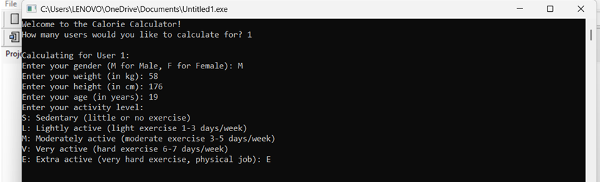
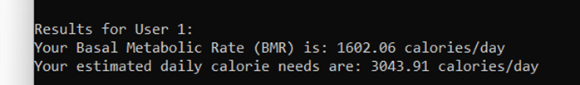

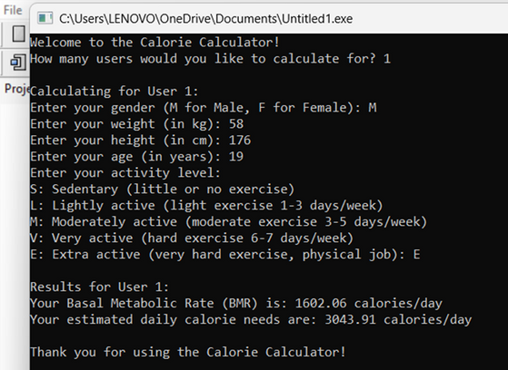
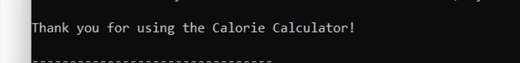
Result of the code
1. Inputs:
• The user provides details like gender, weight, height, age, and activity level for one or more users.
2. Calculations:
• For each user, the program calculates:
• BMR (Basal Metabolic Rate): Calories needed if the body is at rest.
• Daily Calorie Needs: Based on BMR and activity level.
3. Output eg:
4. Conclusion:
After processing all users, the program thanks the user and ends.

Slide 9

Conclusions
This program provides a simple and efficient way to calculate daily calorie requirements for individuals based on their gender, weight, height, age, and activity level. By using the Basal Metabolic Rate (BMR) and applying an activity multiplier, the program delivers personalized results to help users understand their daily energy needs.

Slide 10

Conclusions
It is particularly useful for:
Tracking calorie intake for weight management.
Understanding the impact of lifestyle and activity levels on calorie requirements.
This program is an example of how programming can simplify health-related calculations, making them accessible and accurate for everyday users.

Slide 11


Thanks

